Slide 1
Kubernetes Runtimes & Kata Container
huoqif@cn.ibm.com

Slide 2
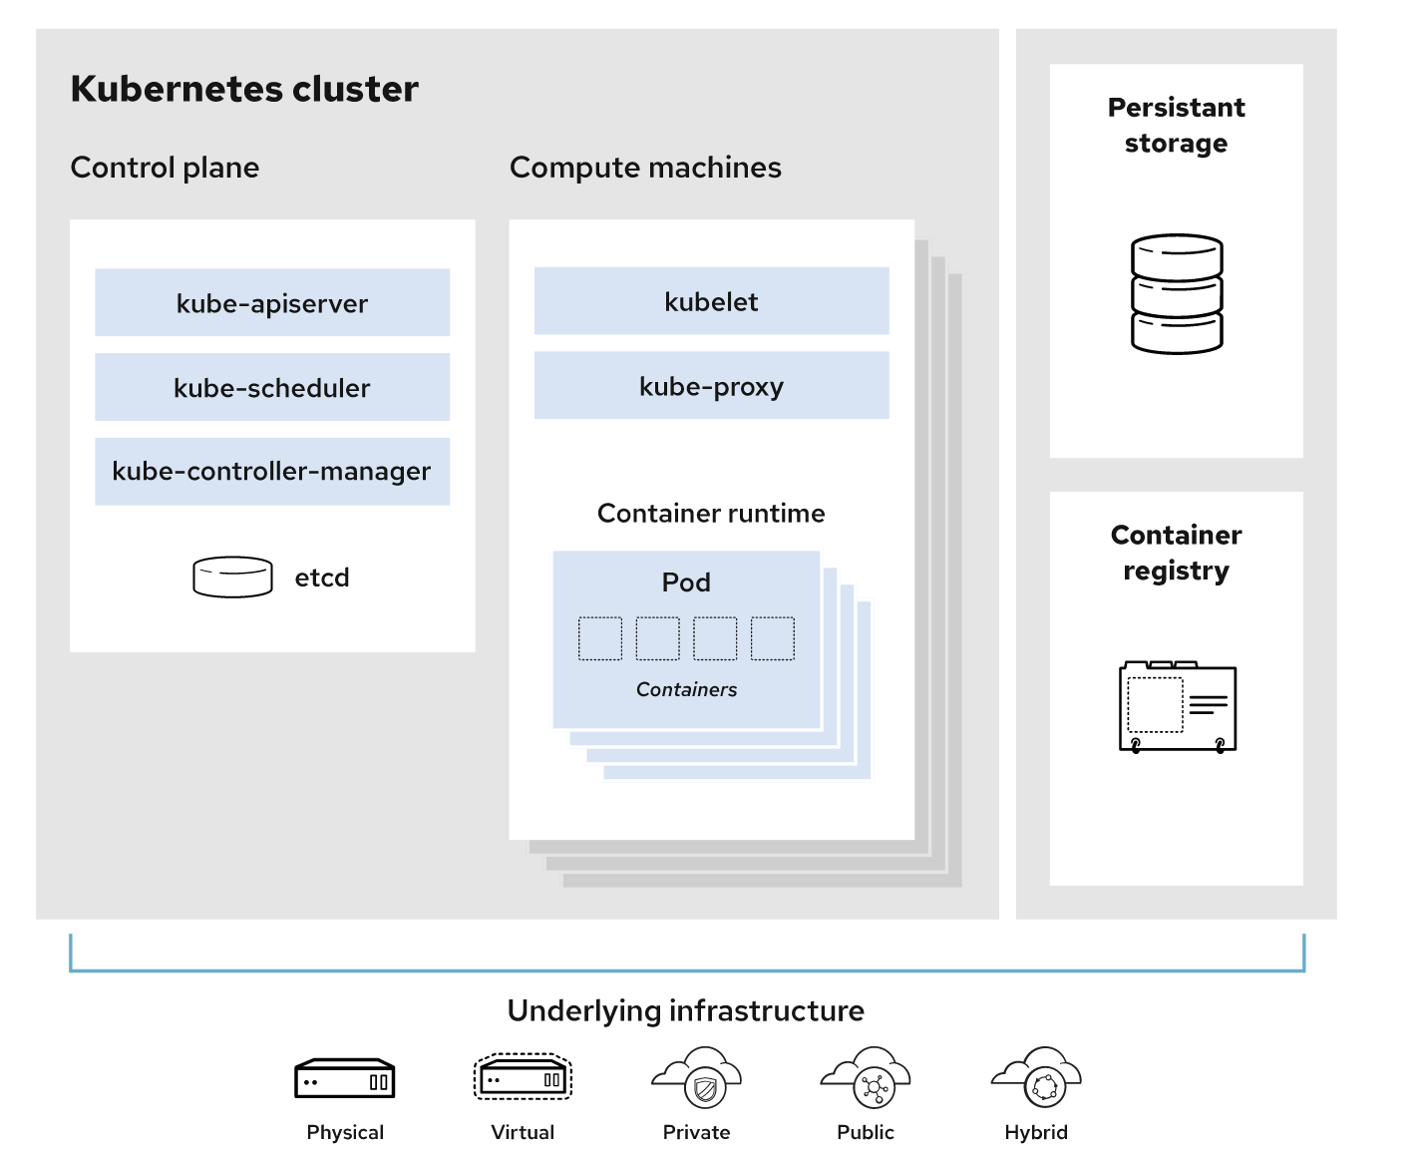
K8s Overview

Slide 3
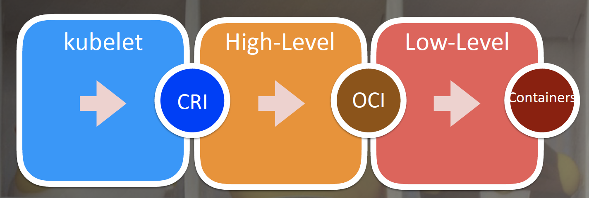
K8s runtime overview
High Level Runtime (CRI – container runtime interface)
Docker, containerd, cri-o
Low level Runtime (OCI - open container initiative)
runc, kata-container, gVisor(runsc)

Slide 4
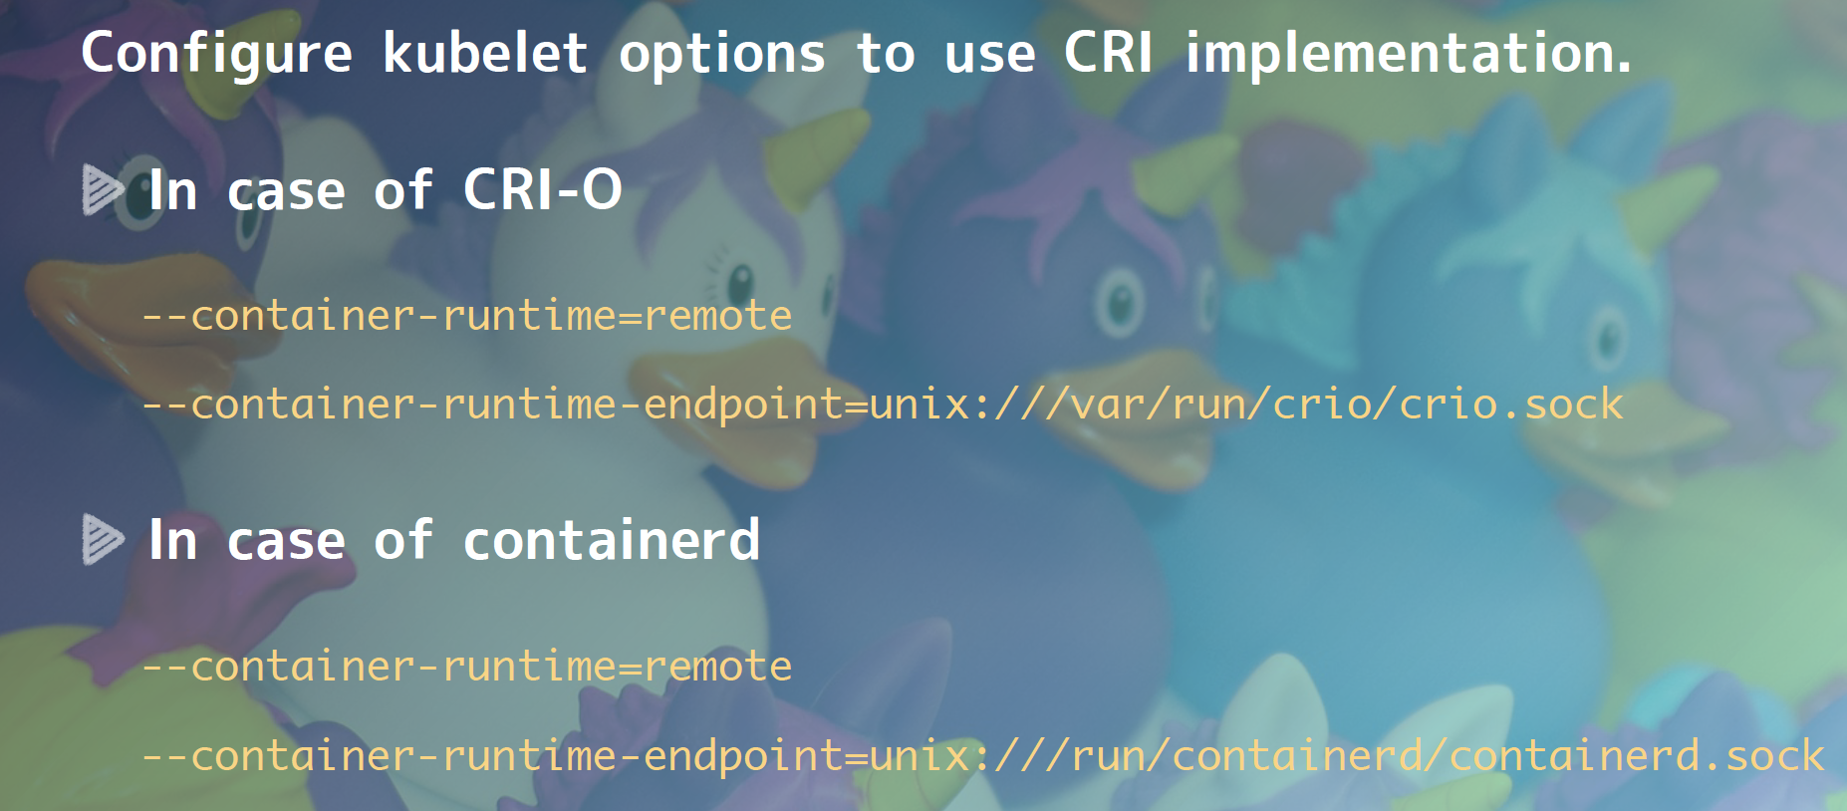
Config CRI

Slide 5
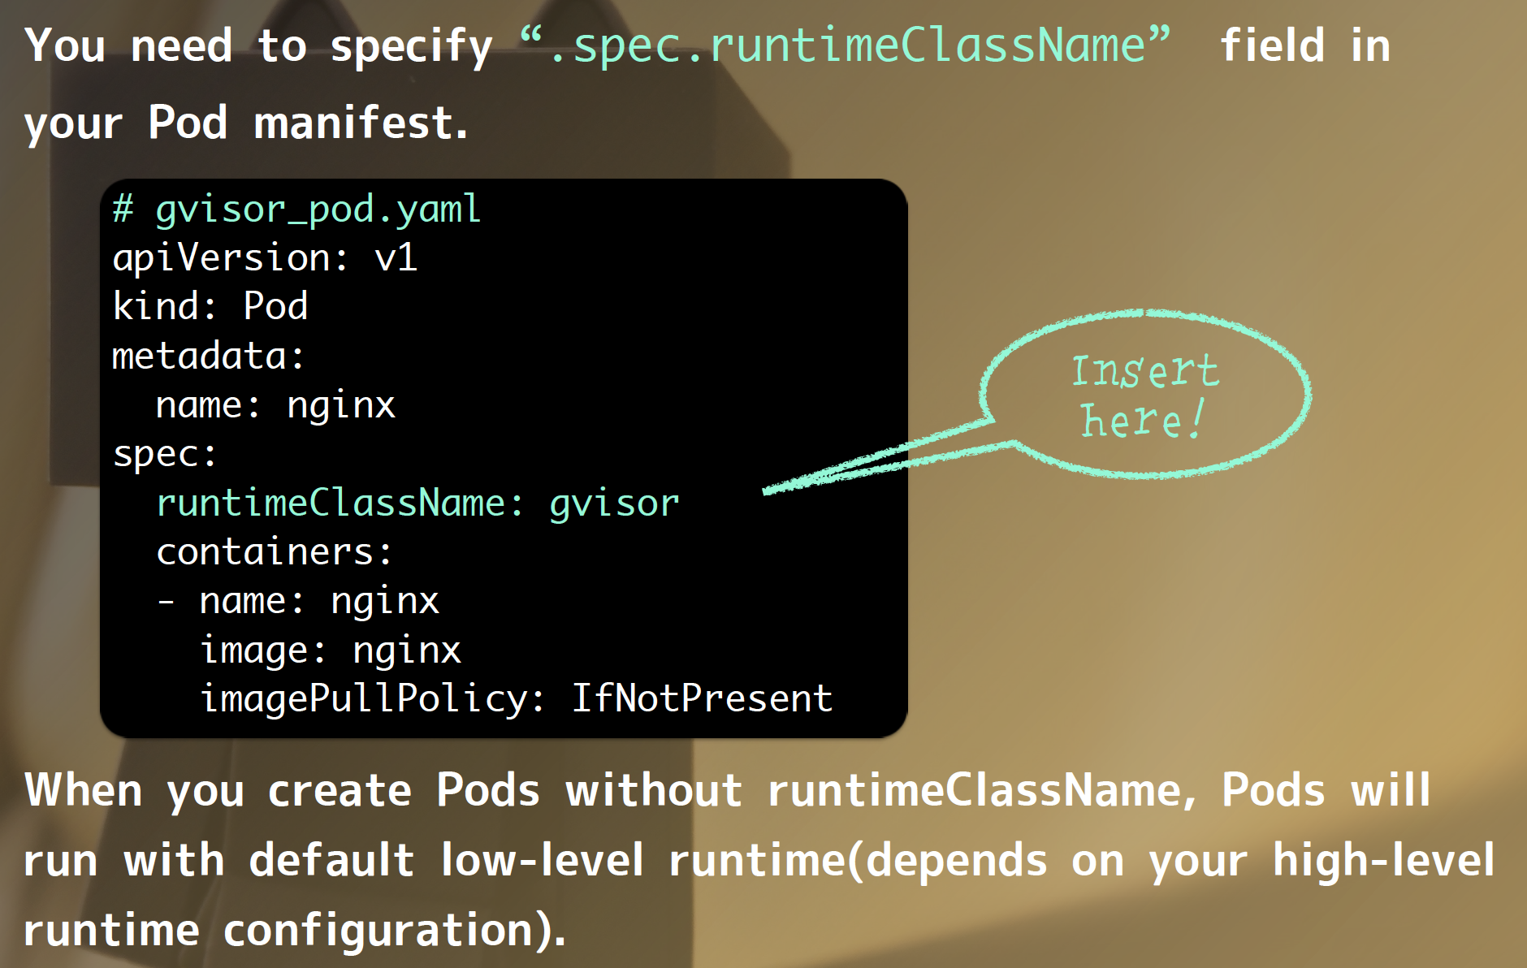
Config OCI

Slide 6
Container history
Namespace
Cgroup
CoW filesystem
LXC
Docker

Slide 7
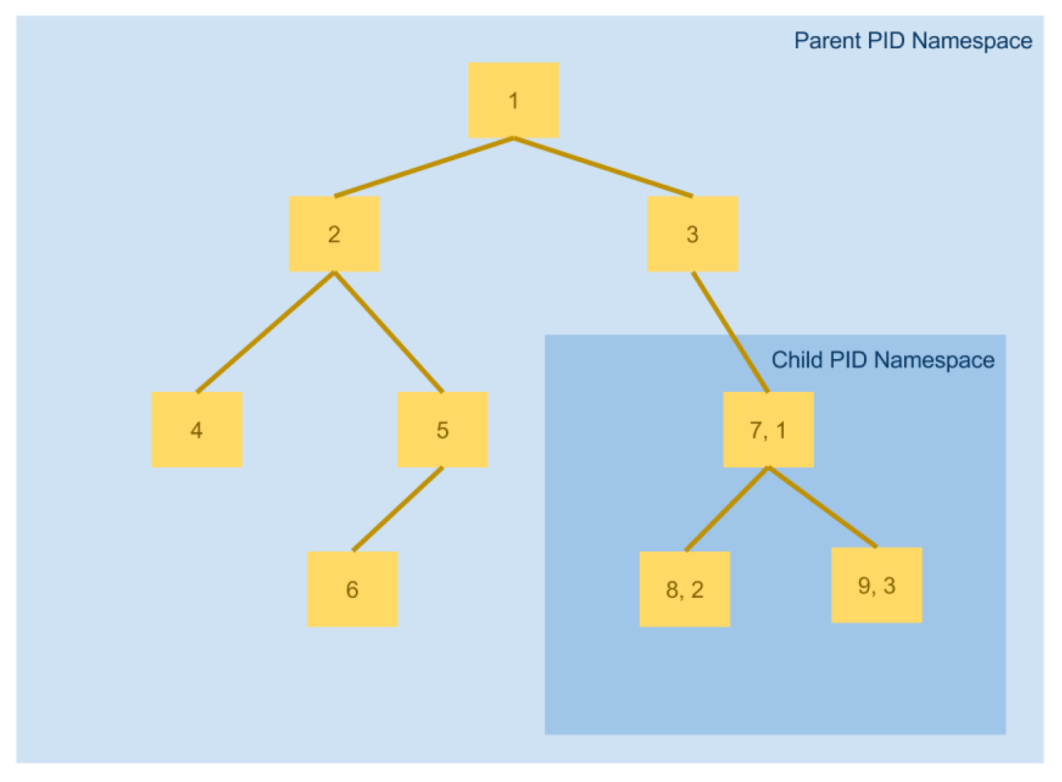
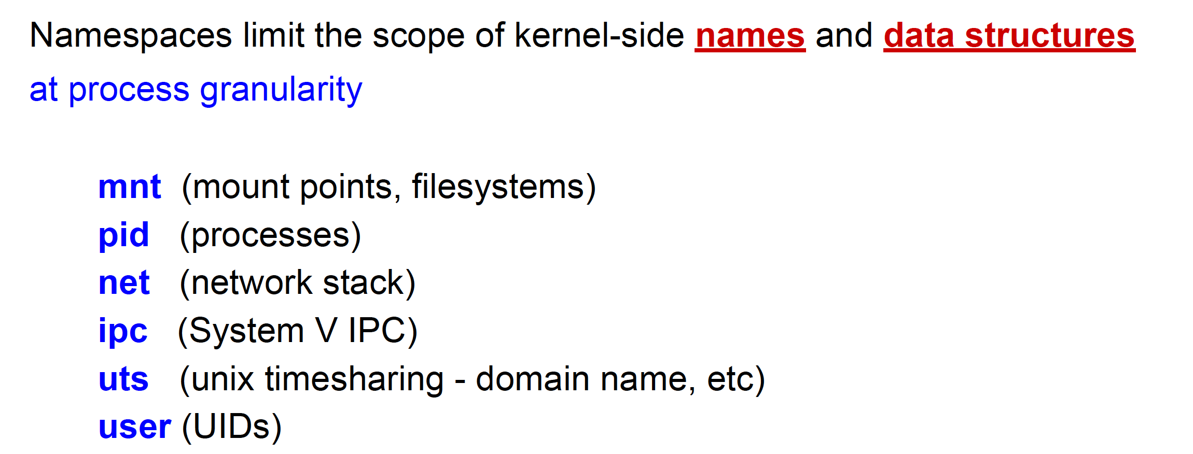
Namespace

Slide 8
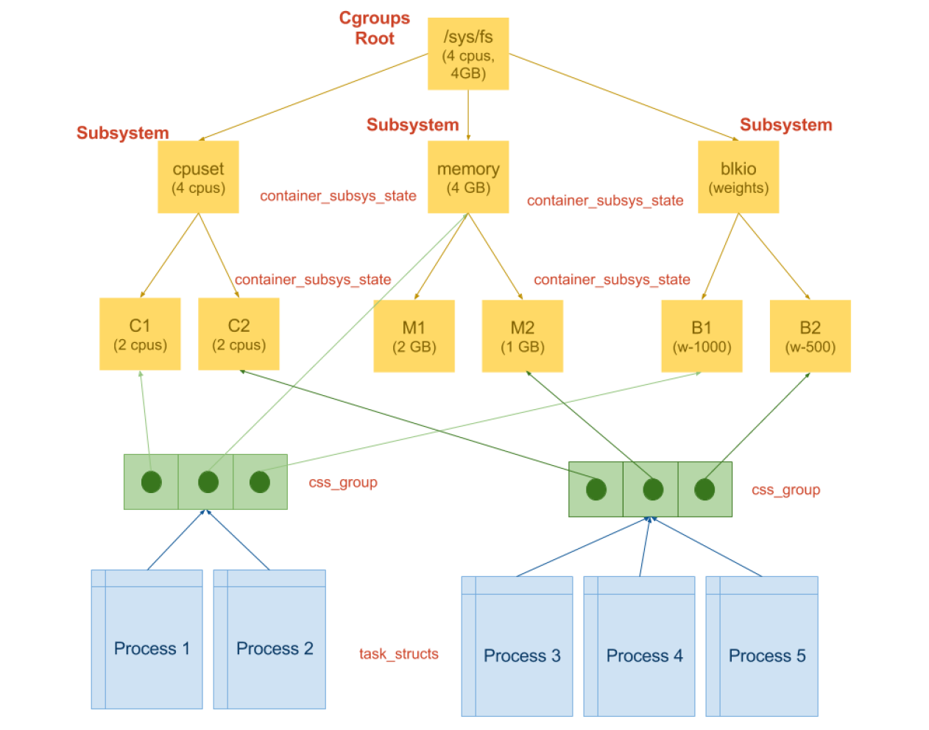
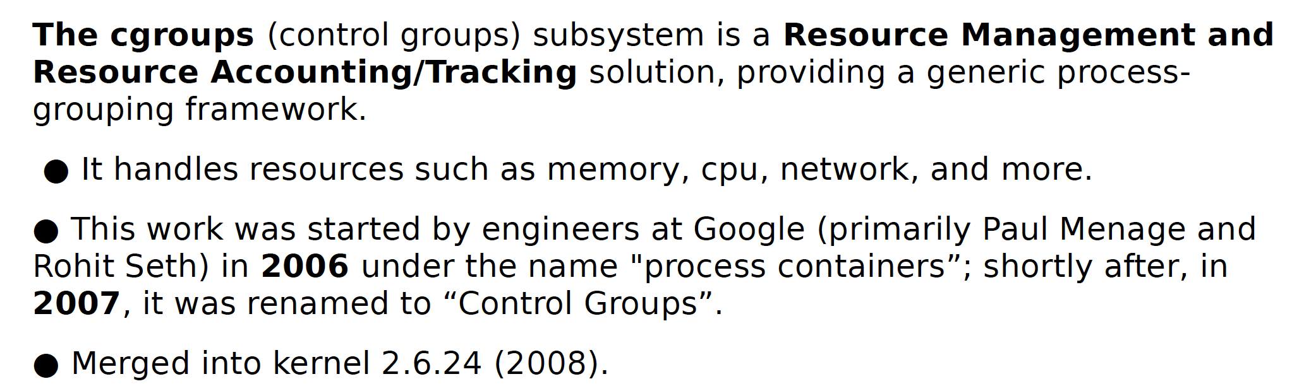
cgroup
Each process: /proc/pid/cgroup.
System-wide: /proc/cgroups

Slide 9
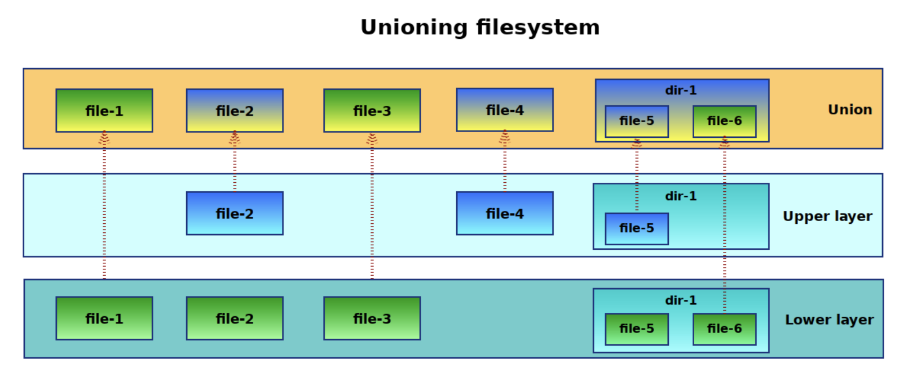
Filesystem

Slide 10
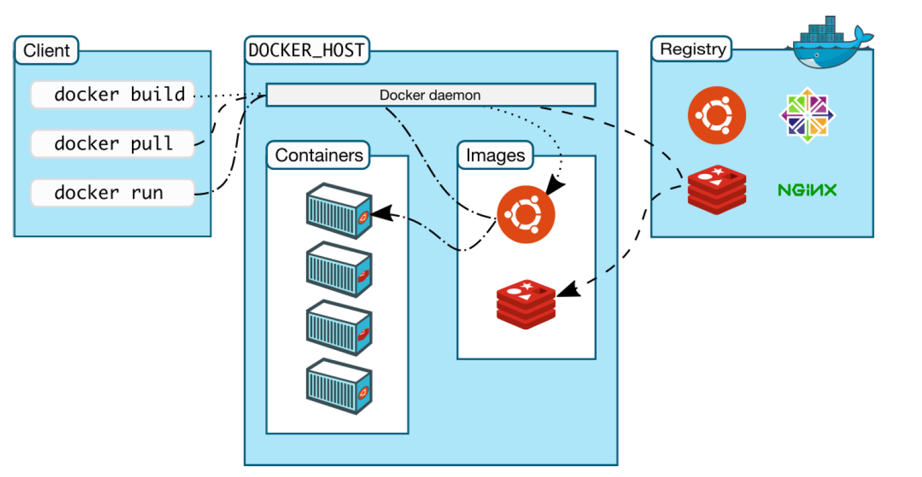
Docker Containers

Slide 11
Docker Containers (cont)

Slide 12
Orchestration platforms
Mesos (Apache)
Fleet (CoreOS)
Swarm (Docker)
K8s (CNCF)
Notes:
- Swarm has the advantage (and disadvantage) of using the standard Docker interface. Whilst this makes it very simple to use Swarm and to integrate it into existing workflows, it may also make it more difficult to support the more complex scheduling that may be defined in custom interfaces.
- Fleet is a low-level and fairly simple orchestration layer that can be used as a base for running higher level orchestration tools, such as Kubernetes or custom systems.
- Kubernetes is an opinionated orchestration tool that comes with service discovery and replication baked-in. It may require some re-designing of existing applications, but used correctly will result in a fault-tolerant and scalable system.
- Mesos is a low-level, battle-hardened scheduler that supports several frameworks for container orchestration including Marathon, Kubernetes, and Swarm. At the time of writing, Kubernetes and Mesos are more developed and stable than Swarm. In terms of scale, only Mesos has been proven to support large-scale systems of hundreds or thousands of nodes. However, when looking at small clusters of, say, less than a dozen nodes, Mesos may be an overly complex solution.

Slide 13
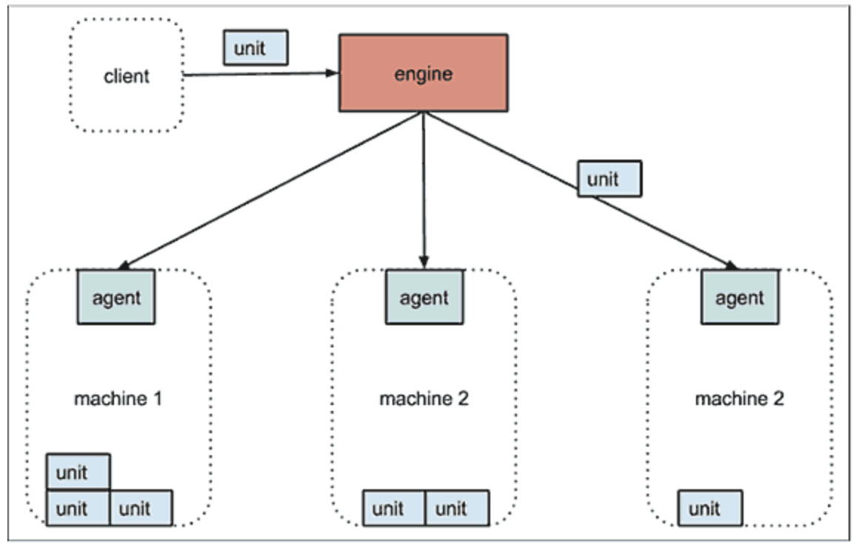
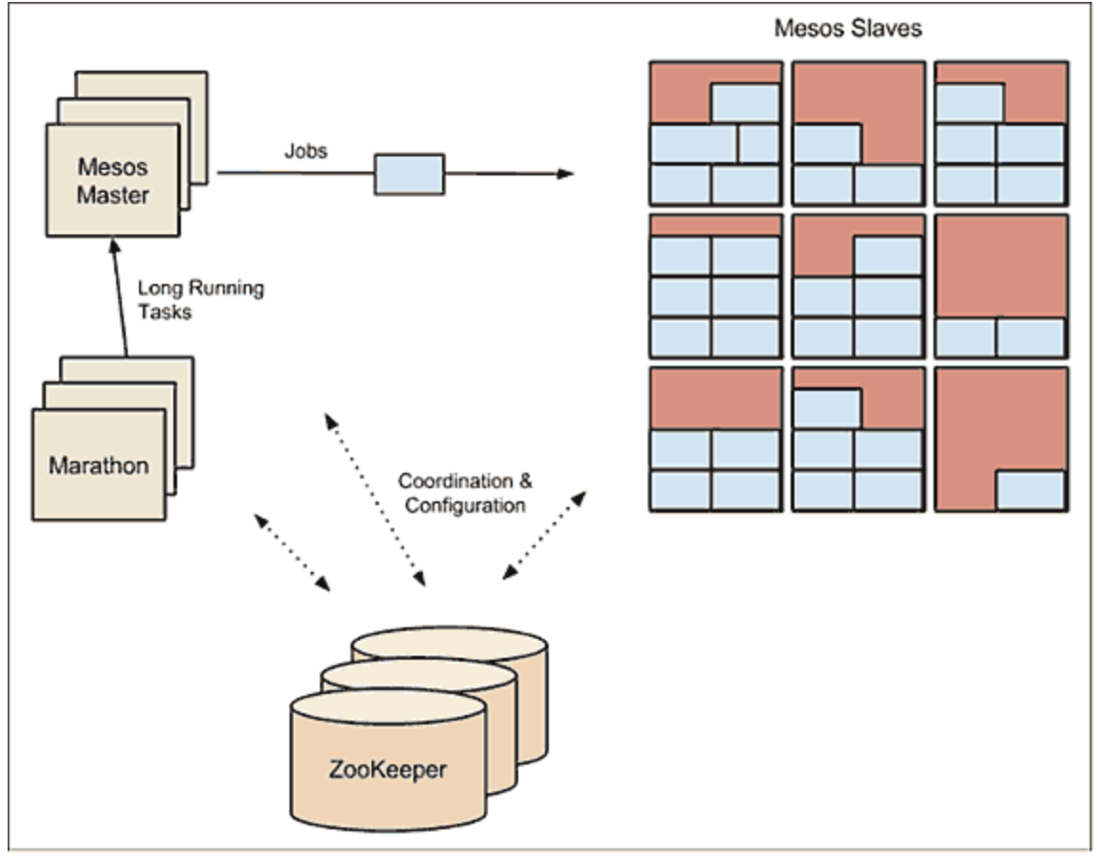
Fleet
Mesos
Notes:
- Swarm has the advantage (and disadvantage) of using the standard Docker interface. Whilst this makes it very simple to use Swarm and to integrate it into existing workflows, it may also make it more difficult to support the more complex scheduling that may be defined in custom interfaces.
- Fleet is a low-level and fairly simple orchestration layer that can be used as a base for running higher level orchestration tools, such as Kubernetes or custom systems.
- Kubernetes is an opinionated orchestration tool that comes with service discovery and replication baked-in. It may require some re-designing of existing applications, but used correctly will result in a fault-tolerant and scalable system.
- Mesos is a low-level, battle-hardened scheduler that supports several frameworks for container orchestration including Marathon, Kubernetes, and Swarm. At the time of writing, Kubernetes and Mesos are more developed and stable than Swarm. In terms of scale, only Mesos has been proven to support large-scale systems of hundreds or thousands of nodes. However, when looking at small clusters of, say, less than a dozen nodes, Mesos may be an overly complex solution.

Slide 14
OCI & CRI & CNCF
2016 年，
CRI
K8s 1.5
2015 年，
CNCF 成立
2015 年，
OCI
Linux Foundation
2014 年，
Kubernetes 项目正式发布
2013年
docker开源
2006-2008年，
Cgroup
Kernel 2.6.24
2008年，
LXC, Linux Containers
2002—2006，
Namespace
Kernel 2.4.19

Slide 15
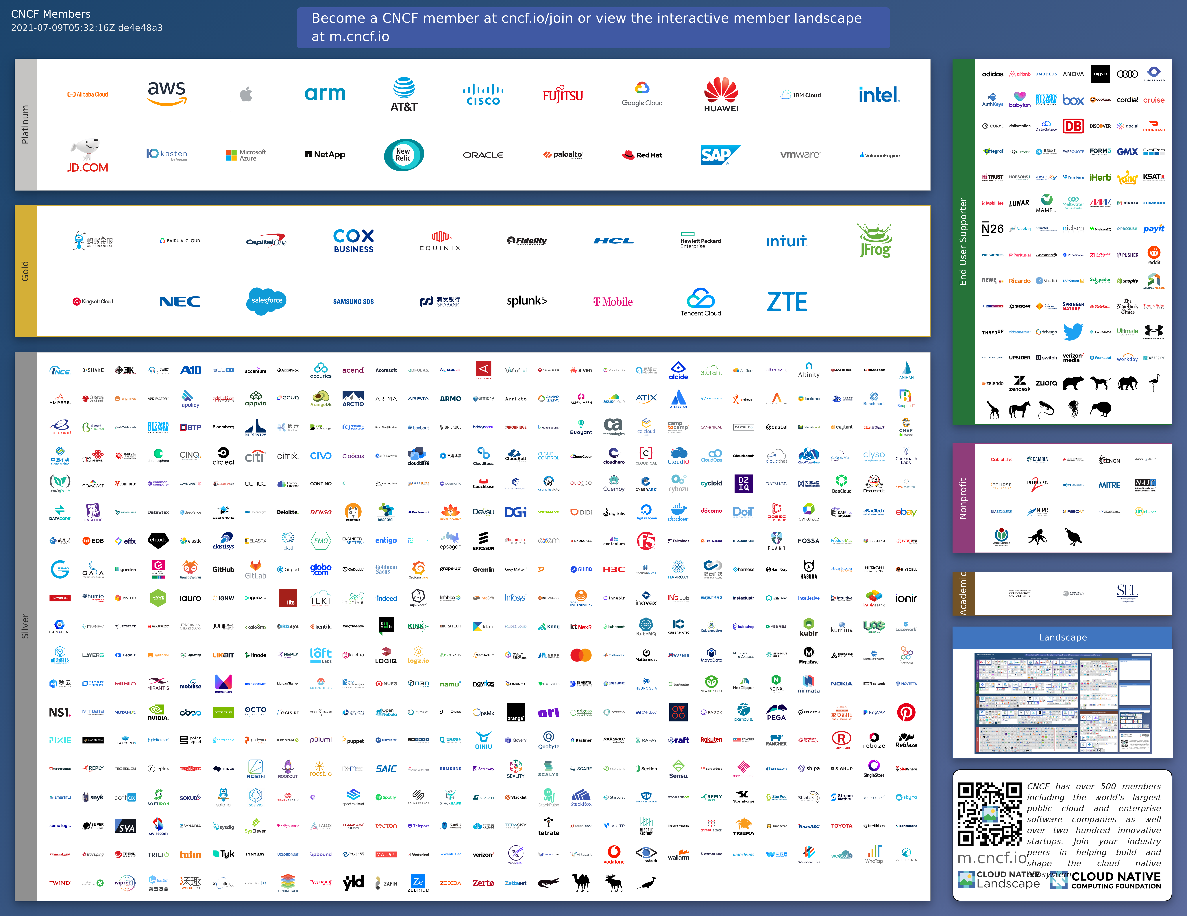
CNCF Members

Slide 16
CNCF Landscape

Slide 17
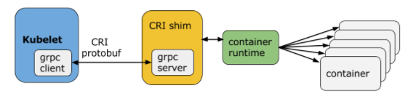
CRI
Container Runtime Interface
Introduced in 2016 in Kubernetes 1.5

Slide 18
OCI
Open Container Initiative
The Open Container Initiative is an open governance structure for the express purpose of creating open industry standards around container formats and runtimes.
Established in June 2015 by Docker and other leaders in the container industry,
Runtime Specification (runtime-spec)
Image Specification (image-spec).
Notes:
The Runtime Specification outlines how to run a “filesystem bundle” that is unpacked on disk. At a high-level an OCI implementation would download an OCI Image then unpack that image into an OCI Runtime filesystem bundle. At this point the OCI Runtime Bundle would be run by an OCI Runtime.

Slide 19
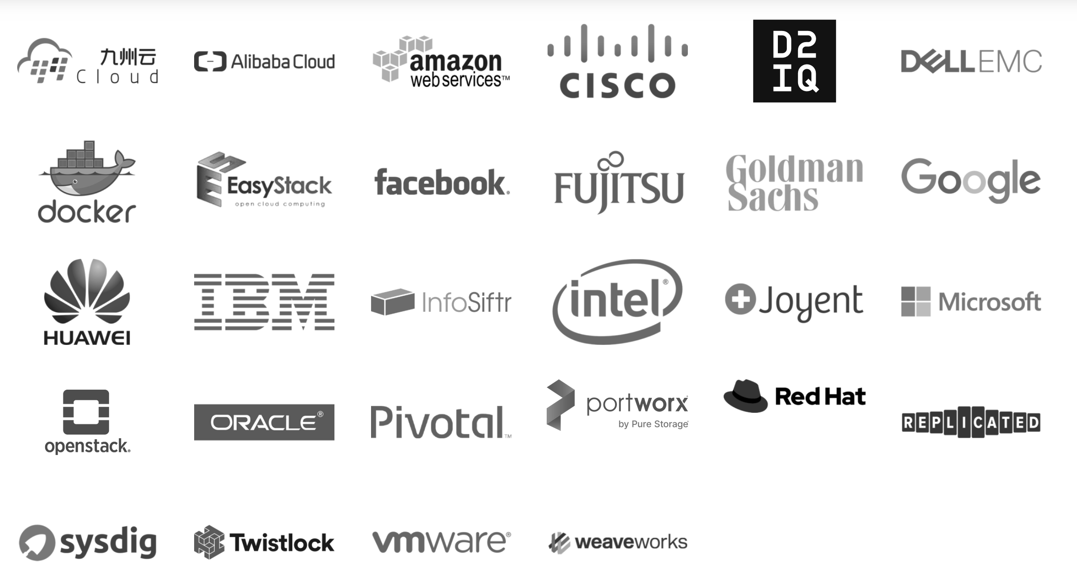
OCI members
Notes:
Open Container Initiative
The Open Container Initiative is an open governance structure for the express purpose of creating open industry standards around container formats and runtimes.
Established in June 2015 by Docker and other leaders in the container industry, the OCI currently contains two specifications: the Runtime Specification (runtime-spec) and the Image Specification (image-spec). The Runtime Specification outlines how to run a “filesystem bundle” that is unpacked on disk. At a high-level an OCI implementation would download an OCI Image then unpack that image into an OCI Runtime filesystem bundle. At this point the OCI Runtime Bundle would be run by an OCI Runtime.

Slide 20


Kata Container
OCI-compatible runtime that enhances the security of container workloads in a lightweight virtual machines.
Works seamlessly with Kubernetes and Docker
and is a drop in replacement for runc
Open Source
Open governance project under the Open Infrastructure Foundation umbrella
Multi
Architecture
x86, ARM, IBM Power, IBM s/390x
Multi
Hypervisor QEMU, Cloud Hypervisor,
Firecracker
Notes:
Kata Containers is an alternative OCI compatible runtime that enhances the security of container workloads in a lightweight virtual machine.
S390 refers to the IBM System z architecture which is a mainframe.
PowerPC is the IBM power architecture

Slide 21
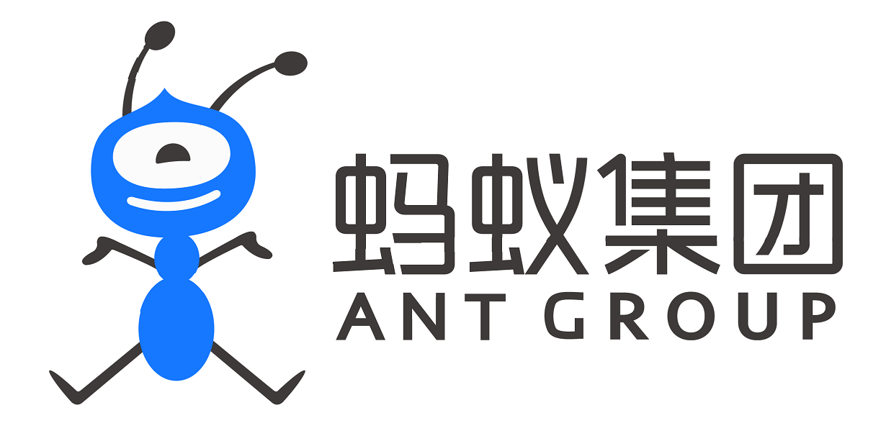
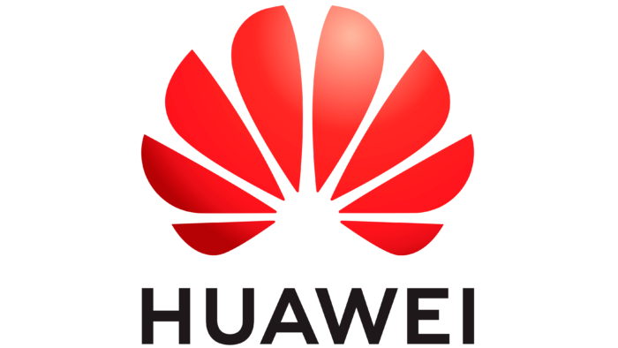















Healthy Growing Community
Notes:
Check out the project’s Infrastructure donors and the companies supporting Kata Containers: https://katacontainers.io/supporters/
Find the Kata Containers community contributor metrics on Kata Bitergia.

Slide 22

How it works
Traditional Containers
Isolation by namespaces, cgroups with shared kernel
Kata Containers
Each container or pod is more isolated in its own lightweight VM
Container A
Container B
Container C
Container A
Container B
Container C
PROCESS A
PROCESS B
PROCESS C
VIRTUAL MACHINE
VIRTUAL MACHINE
VIRTUAL MACHINE
Filter:
Seccomp
MAC
CAPS
Filter:
Seccomp
MAC
CAPS
Filter:
Seccomp
MAC
CAPS
PROCESS A
PROCESS B
PROCESS C
namespaces
namespaces
namespaces
GUEST LINUX KERNEL A
GUEST LINUX KERNEL B
GUEST LINUX KERNEL C
namespaces
namespaces
namespaces
HARDWARE VIRTUALIZATION
HARDWARE VIRTUALIZATION
HARDWARE VIRTUALIZATION
HOST LINUX KERNEL
HOST LINUX KERNEL
CPU
Memory
Network
Storage

Slide 23
Seamless integration
Standard container initiation
OPENSTACK
DOCKER
CRI-O or
Containerd
OCI
KUBERNETES
CRI
PROCESS
runc
container
PodMAN (Rootless)
Kata Containers initiation
OPENSTACK
DOCKER
VM
OCI
PROCESS
Looks and acts like a container using K8s, Docker, or OpenStack Zun
KUBERNETES
CRI
CRI-O or
Containerd
Kata-runtime
container
PodMAN (Rootless)
GUEST LINUX KERNEL
Notes:
Container Runtime Interface CRI. From the kubernetes.io website
This is a plugin interface which enables your kubelet to use a wide variety of container runtimes without requiring a recompile
It consists of protocol buffers, grpc api, and libraries.
Kubelet communicates with the container runtime (or a CRI shim for the runtime) over Unix sockets using the gRPC framework, where kubelet acts as a client and the CRI shim as the server. There is an Image service and a RuntimeService.

Slide 24
Multi-tenant Kubernetes example
Standard Containers
Kata Containers
NODE 1
NODE 1
KUBERNETES
KUBERNETES
KERNEL
KERNEL
KATA VM
KATA VM
KATA VM
KATA VM
KATA VM
POD
POD
POD
POD
POD
POD
POD
POD
POD
POD
CONTAINER
CONTAINER
CONTAINER
CONTAINER
CONTAINER
CONTAINER
CONTAINER
CONTAINER
CONTAINER
CONTAINER
CONTAINER
CONTAINER
CONTAINER
CONTAINER
CONTAINER
CONTAINER
CONTAINER
CONTAINER
CONTAINER
CONTAINER
CONTAINER
CONTAINER
CONTAINER
KERNEL
KERNEL
KERNEL
KERNEL
NODE 2
NODE 3
NODE 4
NODE 2
Isolate sensitive workloads by node
Isolate sensitive workloads within a node
Notes:
A node could be a virtual machine or a bare metal machine
Untrusted or sensitive workloads like the ones shaded in red can be run on the same Node with Kata.

Slide 25

Speed of a container
$ kubectl apply -f nginx.yml
Create
Start
VM boot
Kernel
Agent
Start pod
Prepare container image
Prepare volumes
hotplug

Slide 26
Kata Containers integration with Docker, Kubernetes, and OpenStack
VIRTUAL MACHINE
Creates VM
Starts shim
DOCKER
OCI cmd/spec
gRPC
Container
Command
Container
Exec
Kata-runtime
Facilitates lifecycle of container
Creates cgroups inside VM
KUBERNETES
container
Kata-Shim
namespaces
PodMAN
I/O
gRPC
Kata-Shim
KATA AGENT
OPENSTACK
KATA KERNEL
Maps container process to Docker or Kubernetes
HYPERVISOR
HYPERVISOR VSOCK socket

Slide 27
Kubernetes Containerd v2 shim integration Kata Containers v1.5 and later
VIRTUAL MACHINE
OCI cmd/spec
gRPC
Container
Command
Container
Exec
KUBERNETES
Containerd-kata-shim-v2
container
I/O
gRPC
namespaces
AGENT
KERNEL
HYPERVISOR
HYPERVISOR VSOCK socket

Slide 28
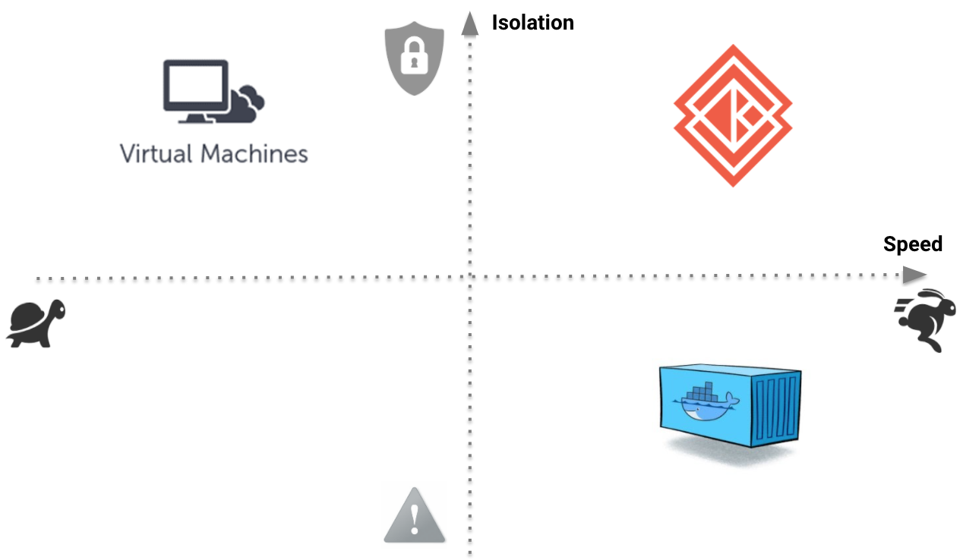
Evolution
The speed of containers,
the security of VMs.

Slide 29
Future of Kata
Confidential Container ??

